Slide 1
2.2 Threads

Slide 2
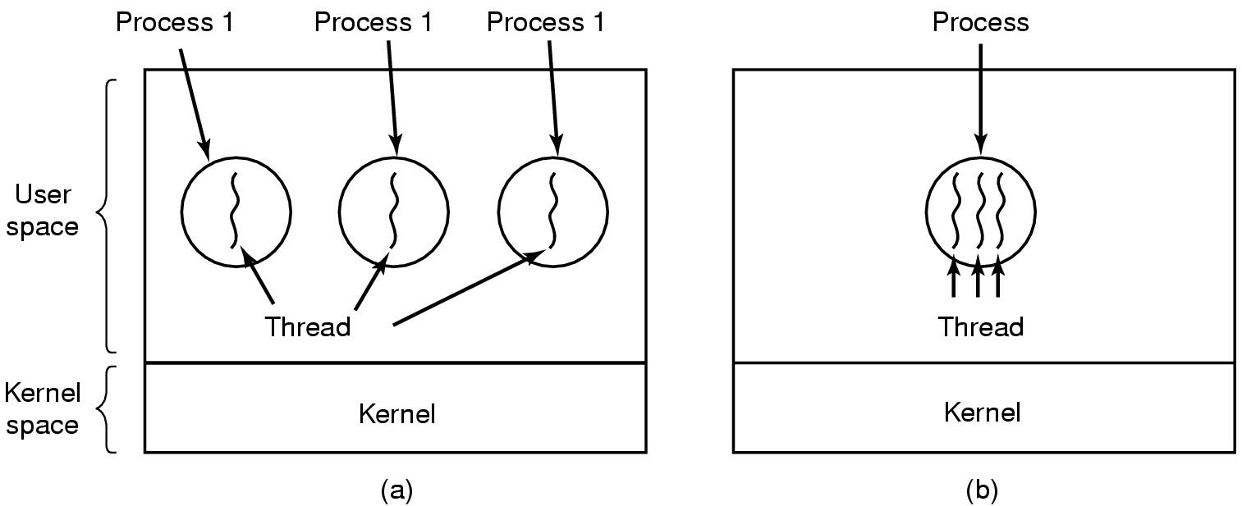
The Thread Model
(a) Three processes each with one thread
(b) One process with three threads
A thread is a single sequential flow of control within a program. A single thread also has a beginning, a sequence, and an end. However, a thread itself is not a program; a thread cannot run on its own. Rather, it runs within a program.

Slide 3
Process with single thread
A process:
Address space (text section, data section)
Single thread of execution
program counter
registers
Stack
Other resource (open files, child processes…)

Slide 4
Process with multiple threads
Multiple threads of execution in the same
environment of process
Address space (text section, data section)
Multiple threads of execution, each thread has private set:
program counter
registers
stack
Other resource (open files, child processes…)

Slide 5
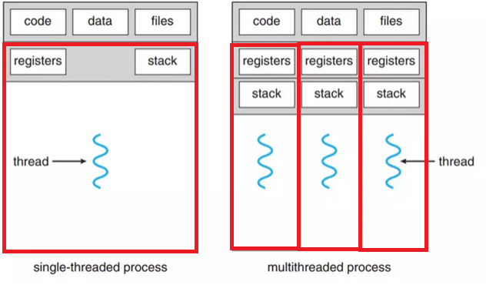
Single and Multithreaded Processes

Slide 6
Thread, Items shared and Items private
Per-process items | Per-thread items
Address space Global variables Open files Child processes Pending alarms Signals and signal handlers Accounting information | Program counter Registers Stack State
Items shared by all threads in a process
Items private to each thread

Slide 7
Threads Benefits
Responsiveness
Resource Sharing
Economy
Utilization of Multiprocessor Architectures

Slide 8
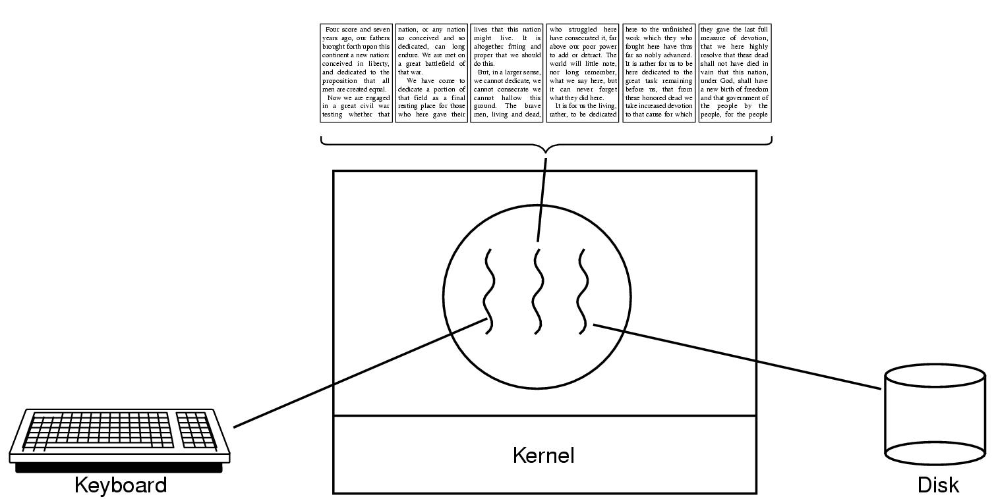
Thread usage (1)
A word processor with three threads

Slide 9
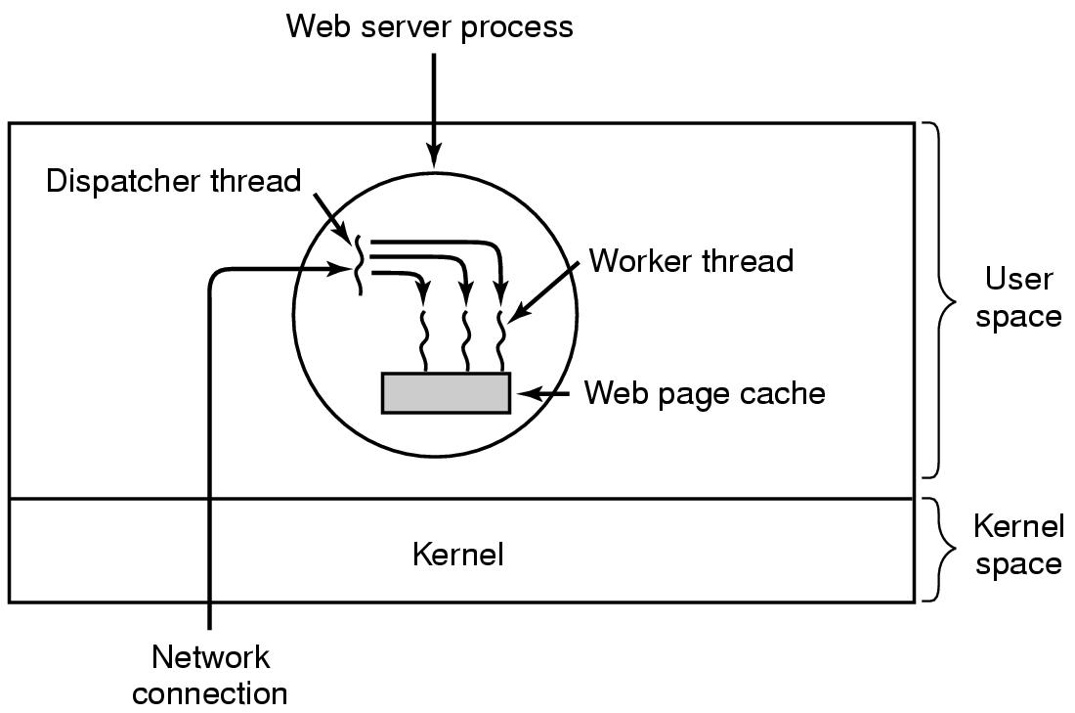
Thread usage (2)
A multithreaded Web server

Slide 10
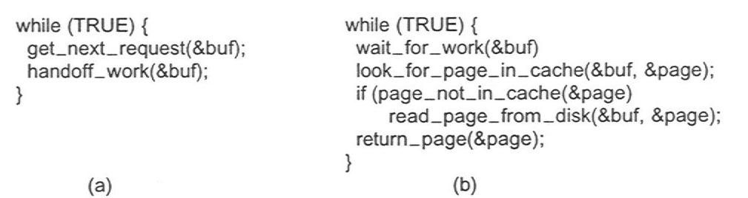
Thread usage (3)
Rough outline of code for previous slide
(a) Dispatcher thread
(b) Worker thread

Slide 11
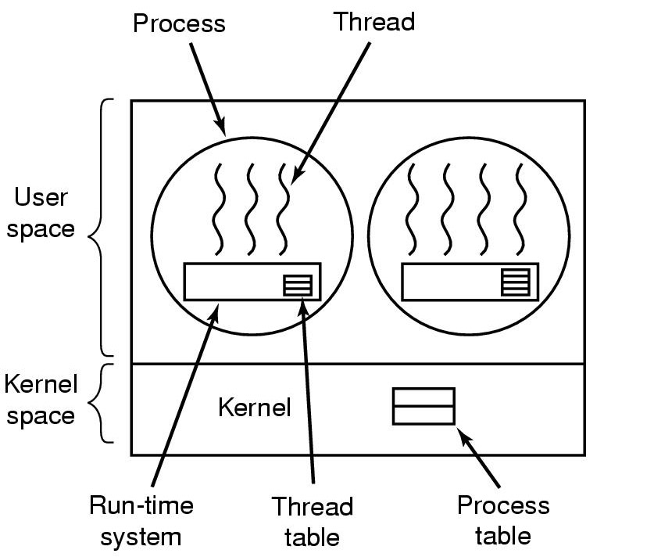
Implementing Threads in User Space (1)
A user-level threads package

Slide 12
Implementing Threads in User Space (2)
Thread library, (run-time system) in user space
thread_create
thread_exit
thread_wait
thread_yield (to voluntarily give up the CPU)
Thread control block (TCB) ( Thread Table) stores states of user thread (program counter, registers, stack)
Kernel does not know the present of user thread

Slide 13
Implementing Threads in User Space (3)
Traditional OS provide only one “kernel thread” presented by PCB for each process.
Blocking problem: If one user thread is blocked ->the kernel thread is blocked, -> all other threads in process are blocked.
user
thread
u
u
u
u
u
u
u
u
u
thread library
thread library
thread library
PCB
PCB
PCB
kernel

Slide 14
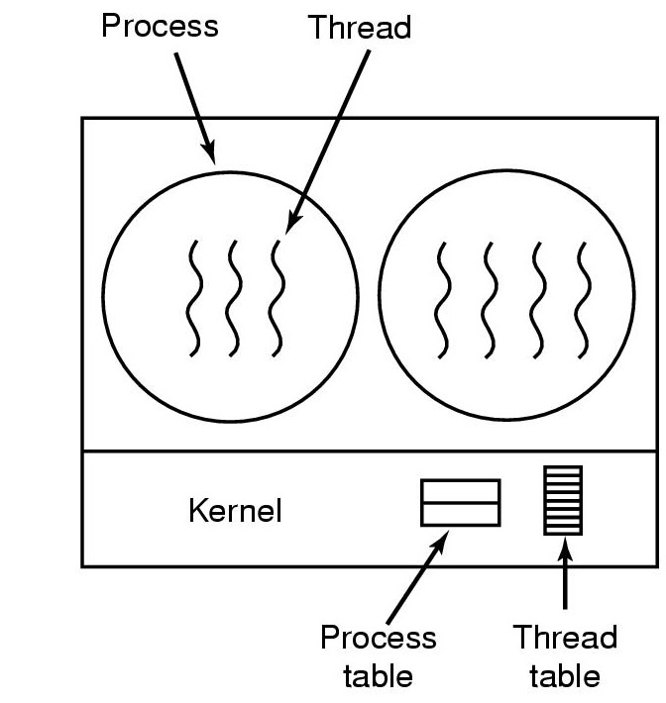
Implementing Threads in the Kernel (1)
A threads package managed by the kernel

Slide 15
Implementing Threads in the Kernel (2)
Multithreading is directly supported by OS:
Kernel manages processes and threads
CPU scheduling for thread is performed in kernel
Advantage of multithreading in kernel
Is good for multiprocessor architecture
If one thread is blocked does not cause the other thread to be blocked.
Disadvantage of Multithreading in kernel
Creation and management of thread is slower

Slide 16
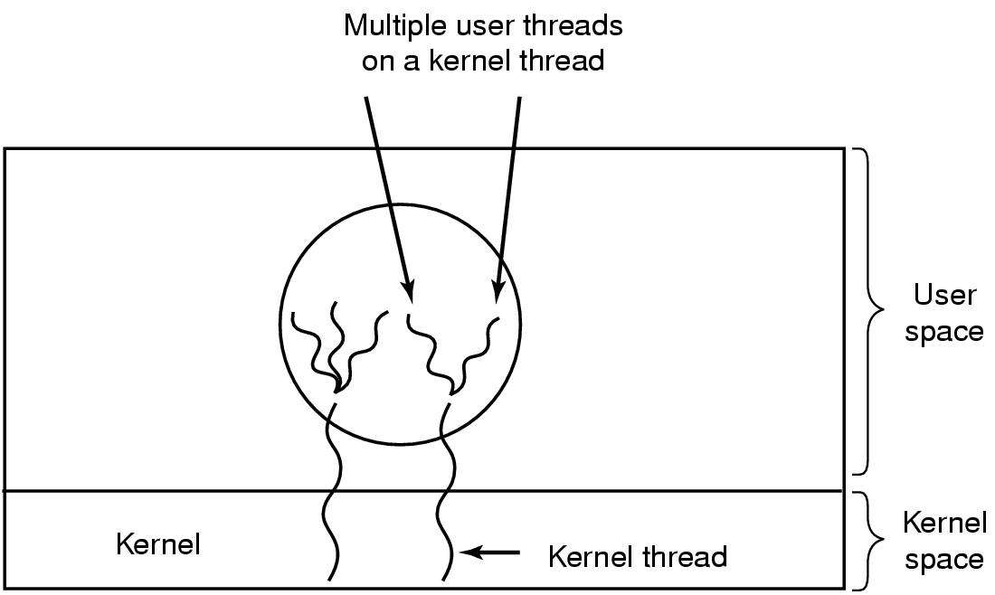
Threads Hybrid Implementations
Multiplexing user-level threads onto kernel- level threads

Slide 17
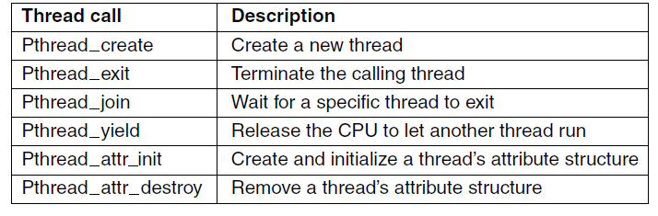
POSIX Threads (1)
To make it possible to write portable threaded programs, IEEE has defined a standard for threads in IEEE standard 1003.1c. The threads package it defines is called Pthreads. Most UNIX systems support it. The standard defines over 60 function calls, which is far too many to go over here. Instead, we will just describe a few of the major ones to give an idea of how it works. The calls we will describe are listed in Fig below:
Some of the Pthreads function calls.

Slide 18
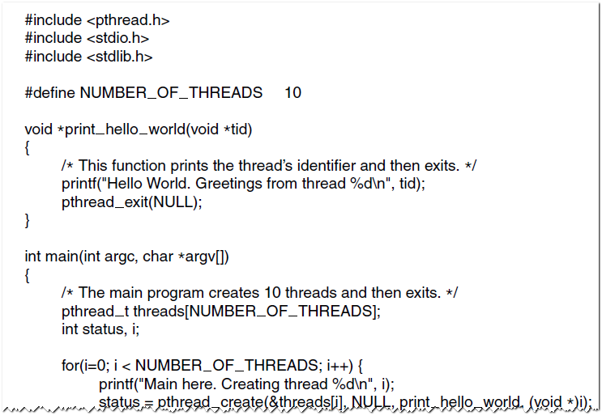
POSIX Threads (2)
An example program using threads.

Slide 19
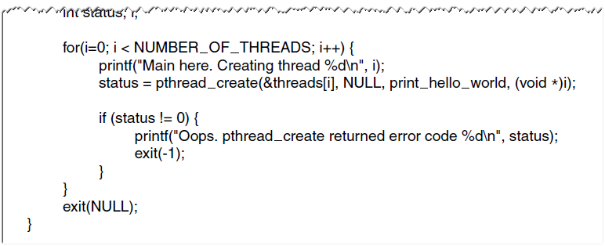
POSIX Threads (3)
An example program using threads.

